Slide 1


E-COMMERCE WEBSITE “EVA”
MINOR PROJECT

Slide 2

Context
Introduction
Problem Statement
Pros and Cons of travelling Site
Language and system used
SDLC
Design
Implementation
Testing
Results
Future Plan

Slide 3
Introduction
EVA, an ecommerce online shopping website that offers a personalized and immersive shopping experience to its users, Its an cutting-edge ecommerce platform designed to meet the evolving needs and preferences of modern consumers. The website's clean and user-friendly design allows for easy navigation and efficient search functionalities .High-resolution images, and customer reviews further assist users in making informed buying decisions.

Slide 4
Problem Statement
The purpose of website is established fact that Internet users are increasing today.
Today One of the main purposes of the website is to facilitate the offline customer online because customers cannot spend their precious time in markets trying to find out the best deal.
There will be many users visiting the site and hence we require a strong and reliable frontend which can withhold the users on our site.

Slide 5
Comparison
Advantages
Disadvantages
Convenience This had made shopping easy as there are no lines to wait so that we can do shopping in minutes. Which saves time and effort.
No Crowds During festivals, weekends, or holidays it is common to see the crowd at shopping places but in this we do not have to face crowds.
Multiple varieties It is one of the best advantages of online shopping. In online shopping, the buyer has multiple options and multiple brands to choose and from at a single place. There is a large volume of stock is available online
Risk of fraud There is a risk of frauds such as hacking, identity theft, credit card scams, phishing, and other scams during online shopping.
Delay in delivery Sometimes buyers have to face an unexpected delay in the delivery of the booked item. Booking an order hardly takes five minutes, but its delivery sometimes takes a delay of 5-10 days.
Returns can be complicated Some of the processes of return or refund are easier, but many sellers make it complicated for the buyer. There can be multiple forms such as labeling, shipping, packaging, tracking etc.

Slide 6
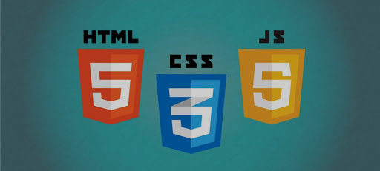

Languages and system used
Windows OS: 8/8.1/10 or mac OS or Linux.
HTML 5
CSS
JavaScript
Browser like chrome, Mozilla etc.

Slide 7
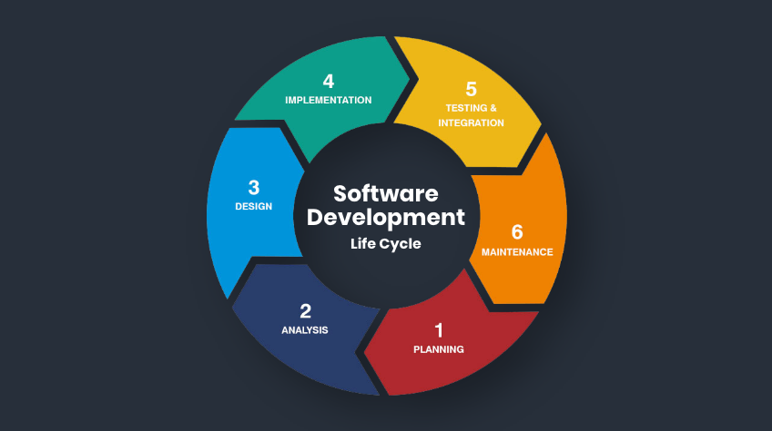
SDLC
System Development Life Cycle
A software life cycle model (also termed process model) is a pictorial and diagrammatic representation of the software life cycle. A life cycle model represents all the methods required to make a software product transit through its life cycle stages.

Slide 8
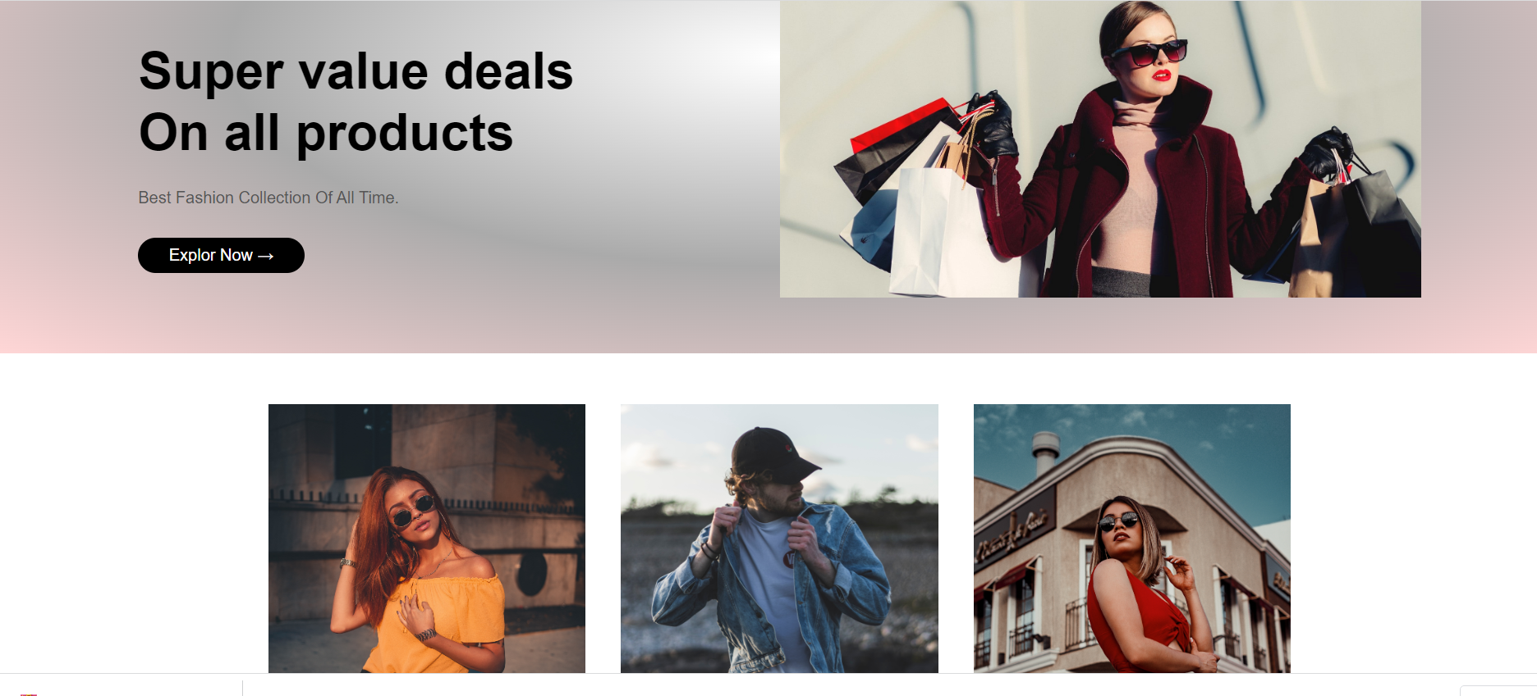
Design Design is very important step performed to make a project successful for this we have to make a full plan and a design.

Slide 9
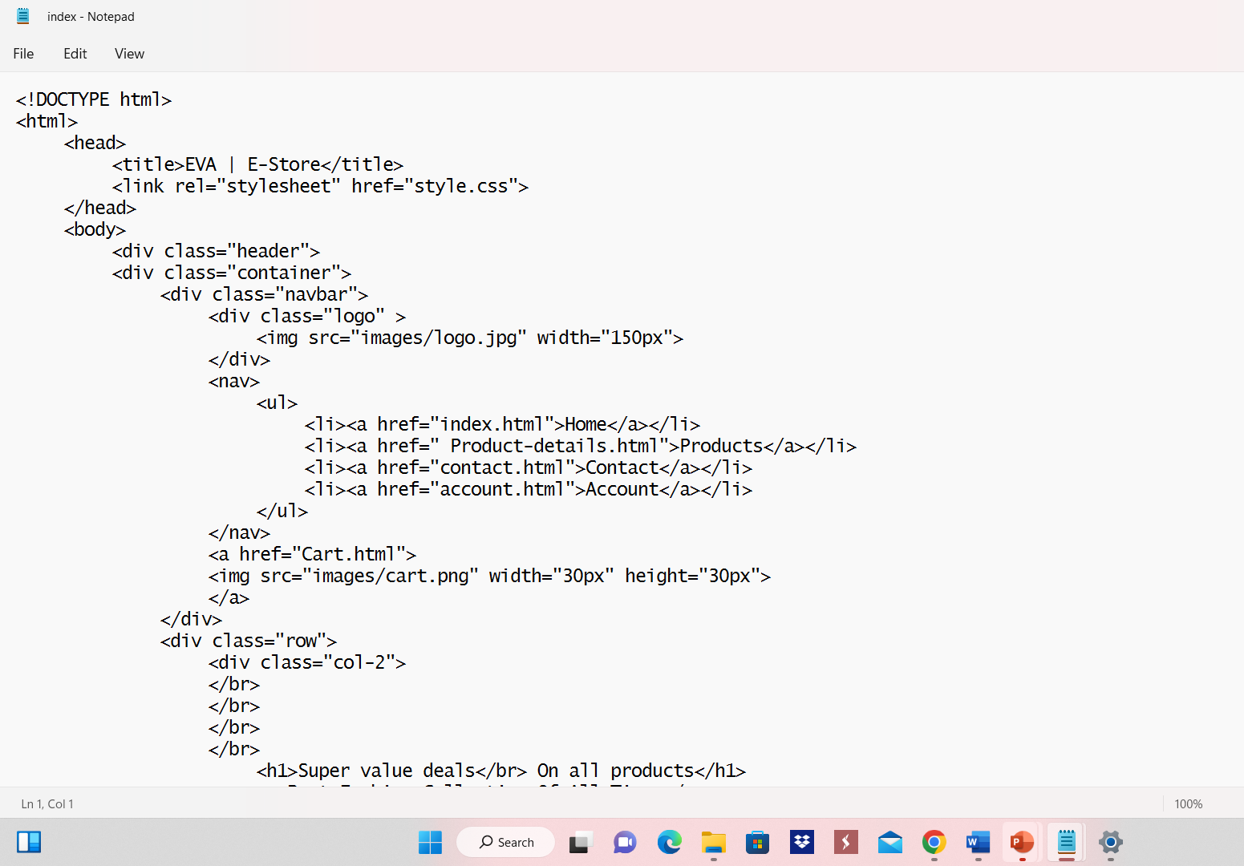
Implementation In this we create a database and do coding and give some inputs to it.

Slide 10

Testing
After giving all inputs we should check that our system is working perfectly or not.

Slide 11
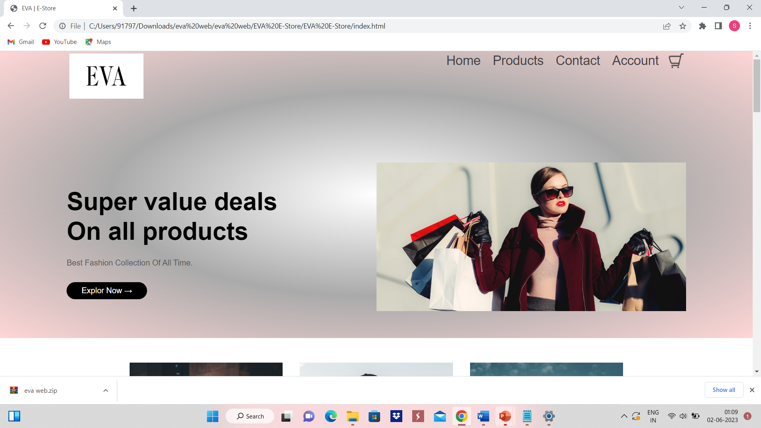
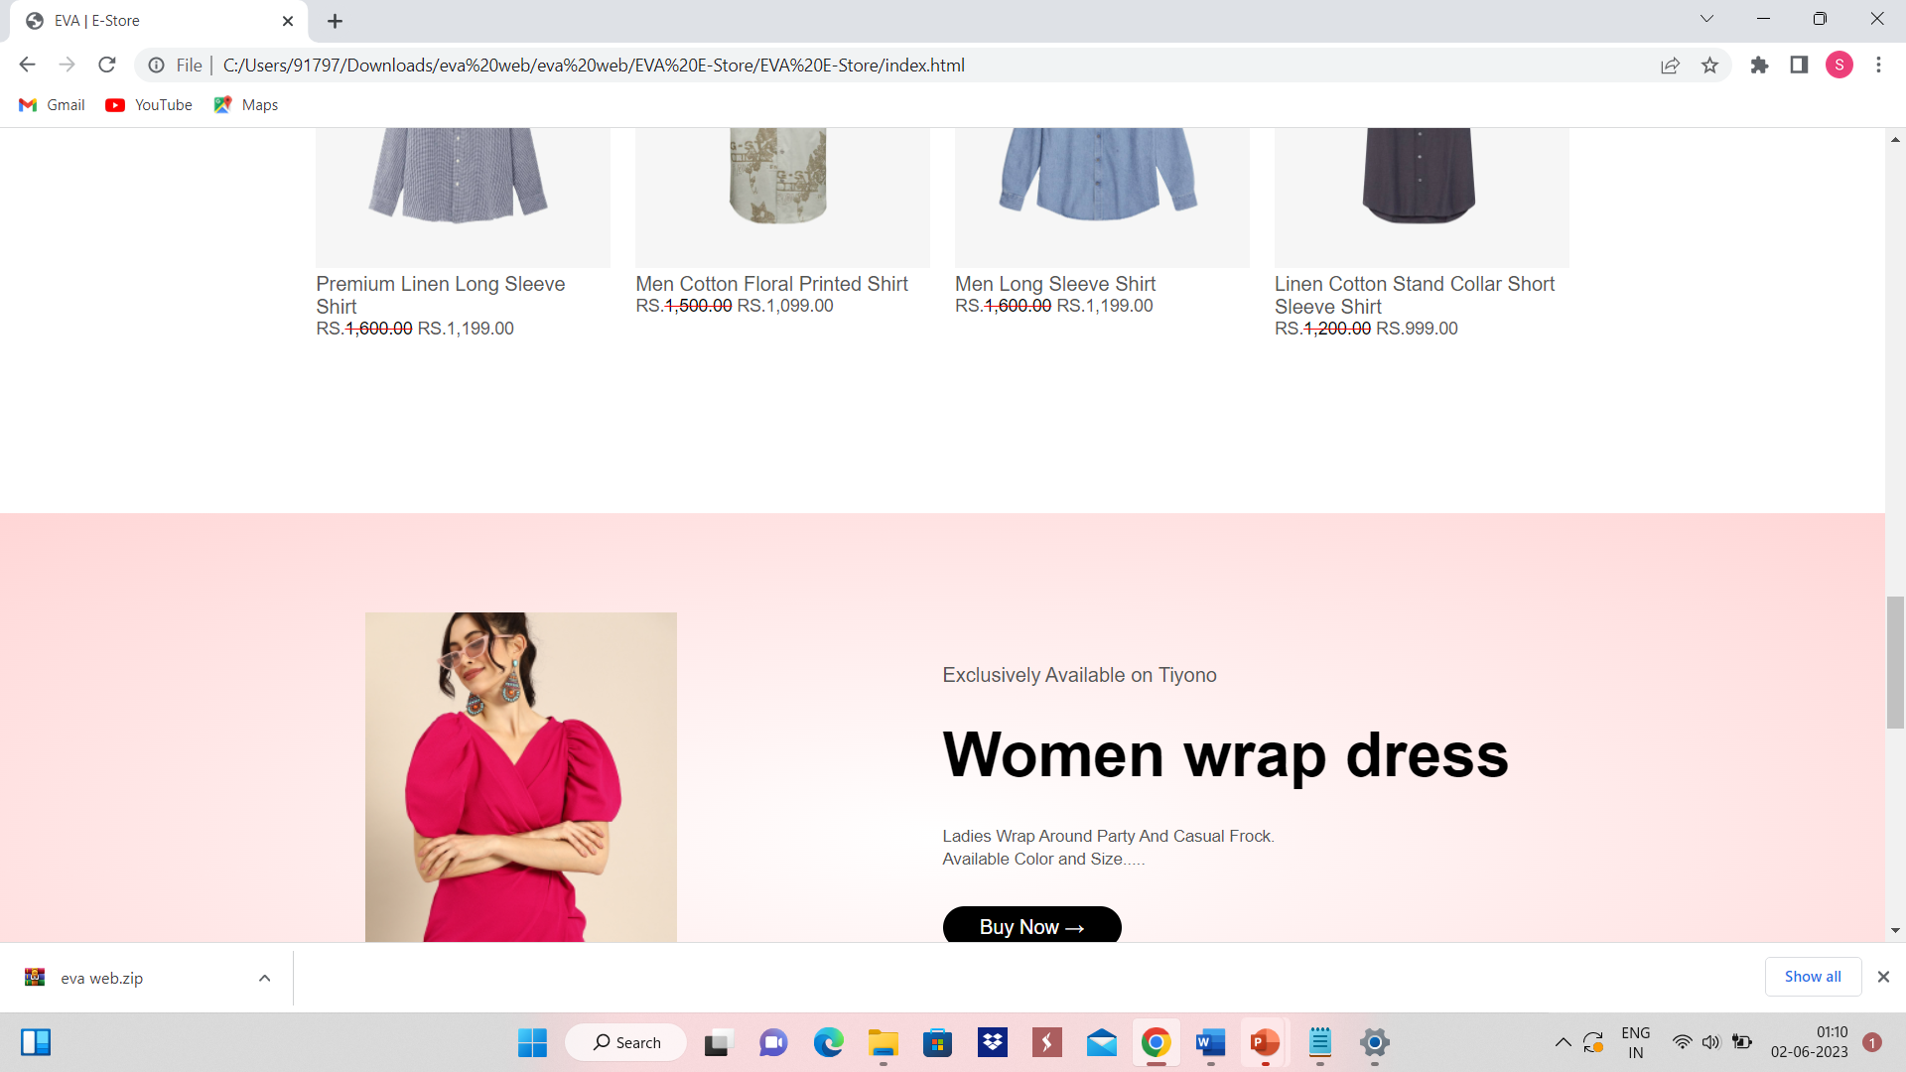
Home Page

Slide 12
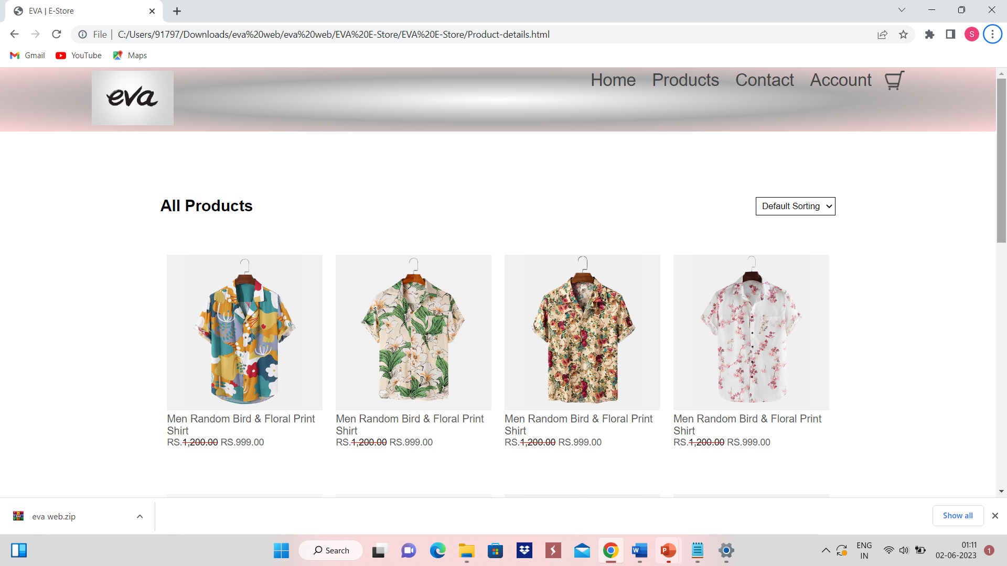
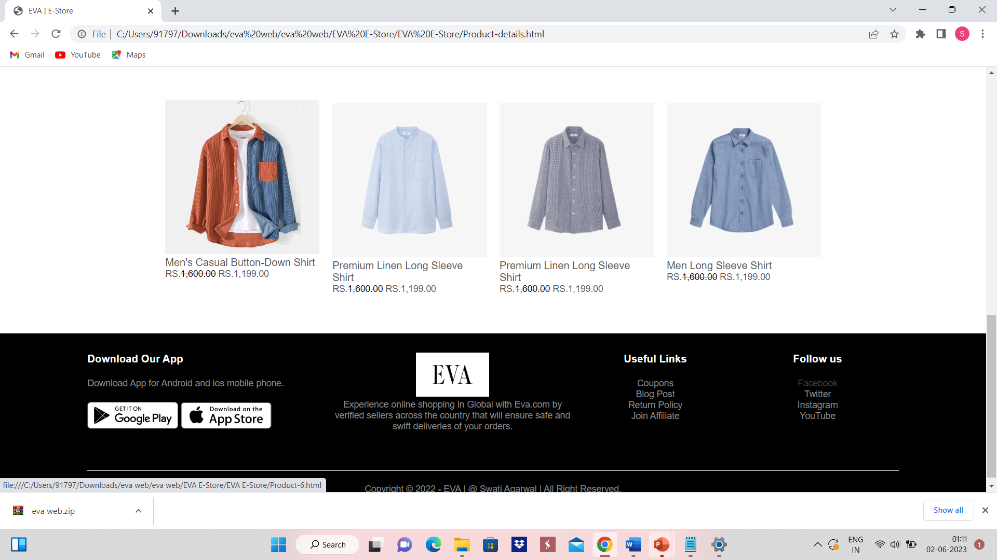
Products Page

Slide 13
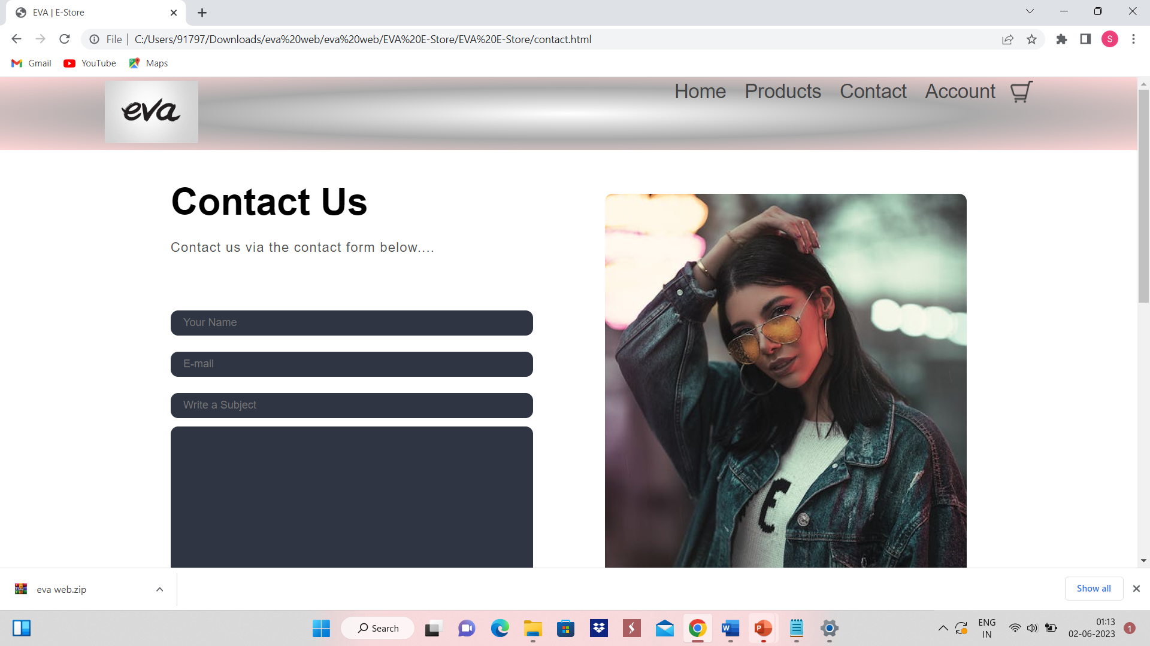
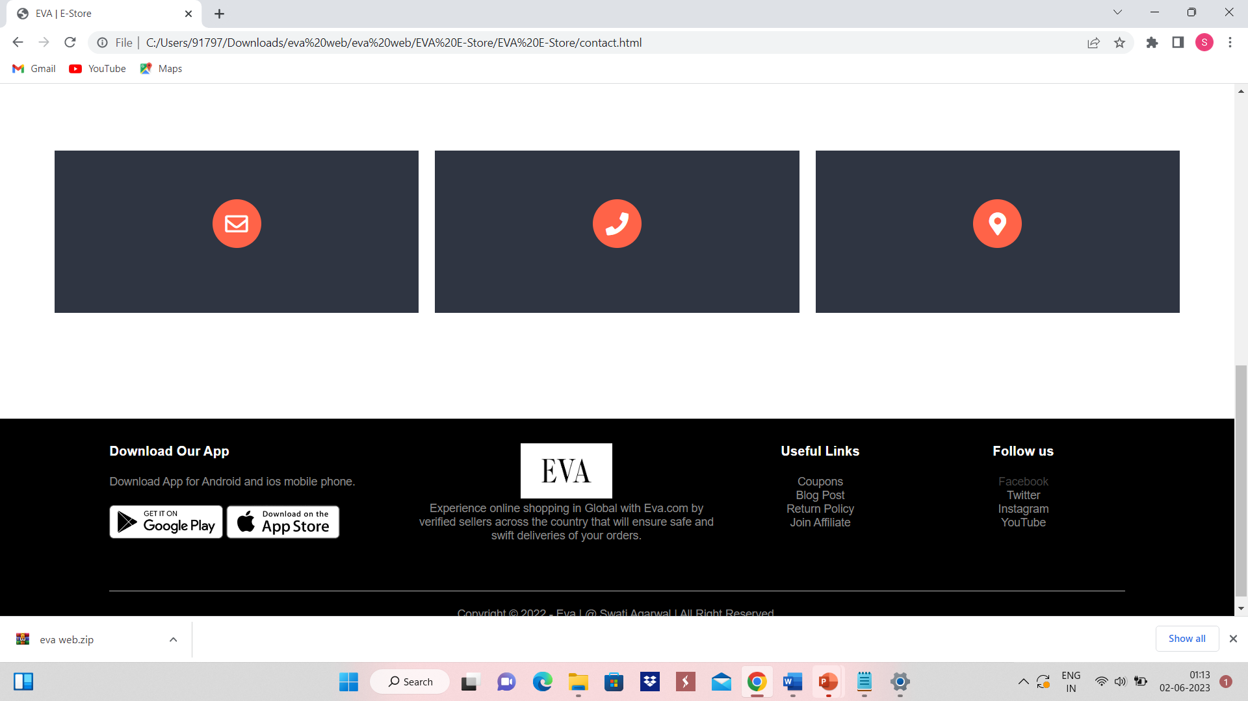
Contact Us Page

Slide 14
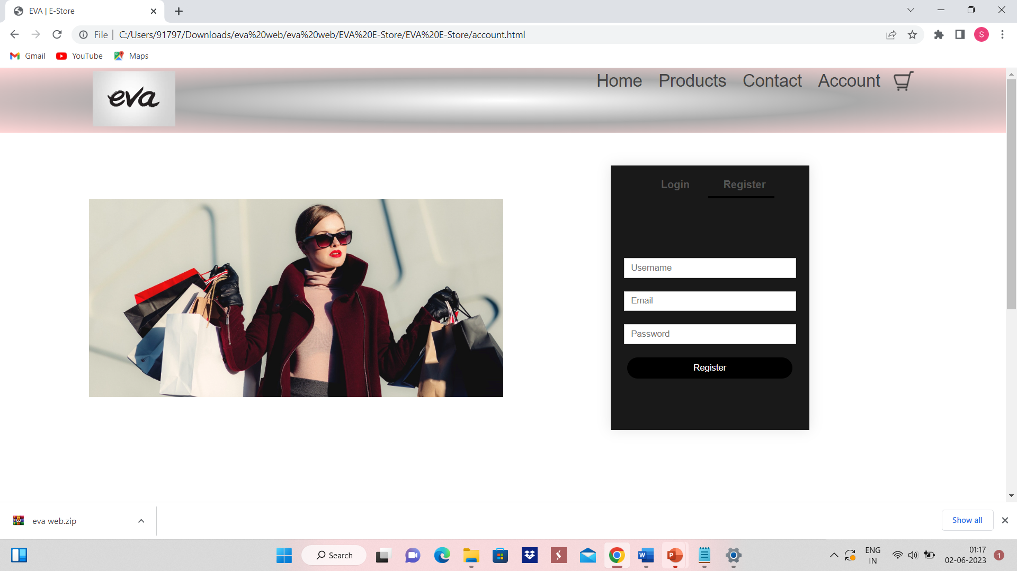
Account Page

Slide 15
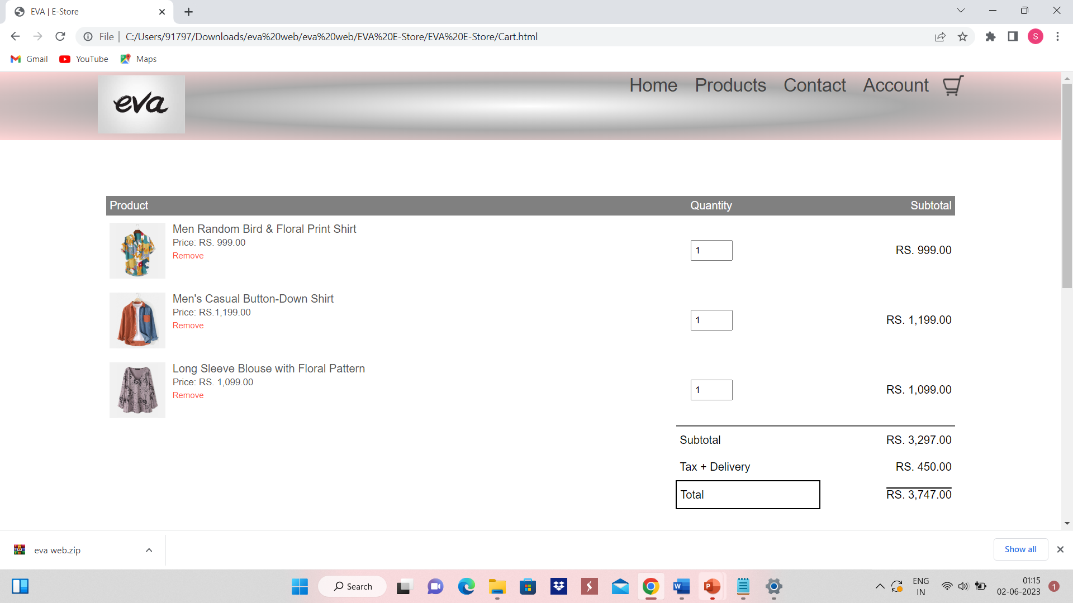
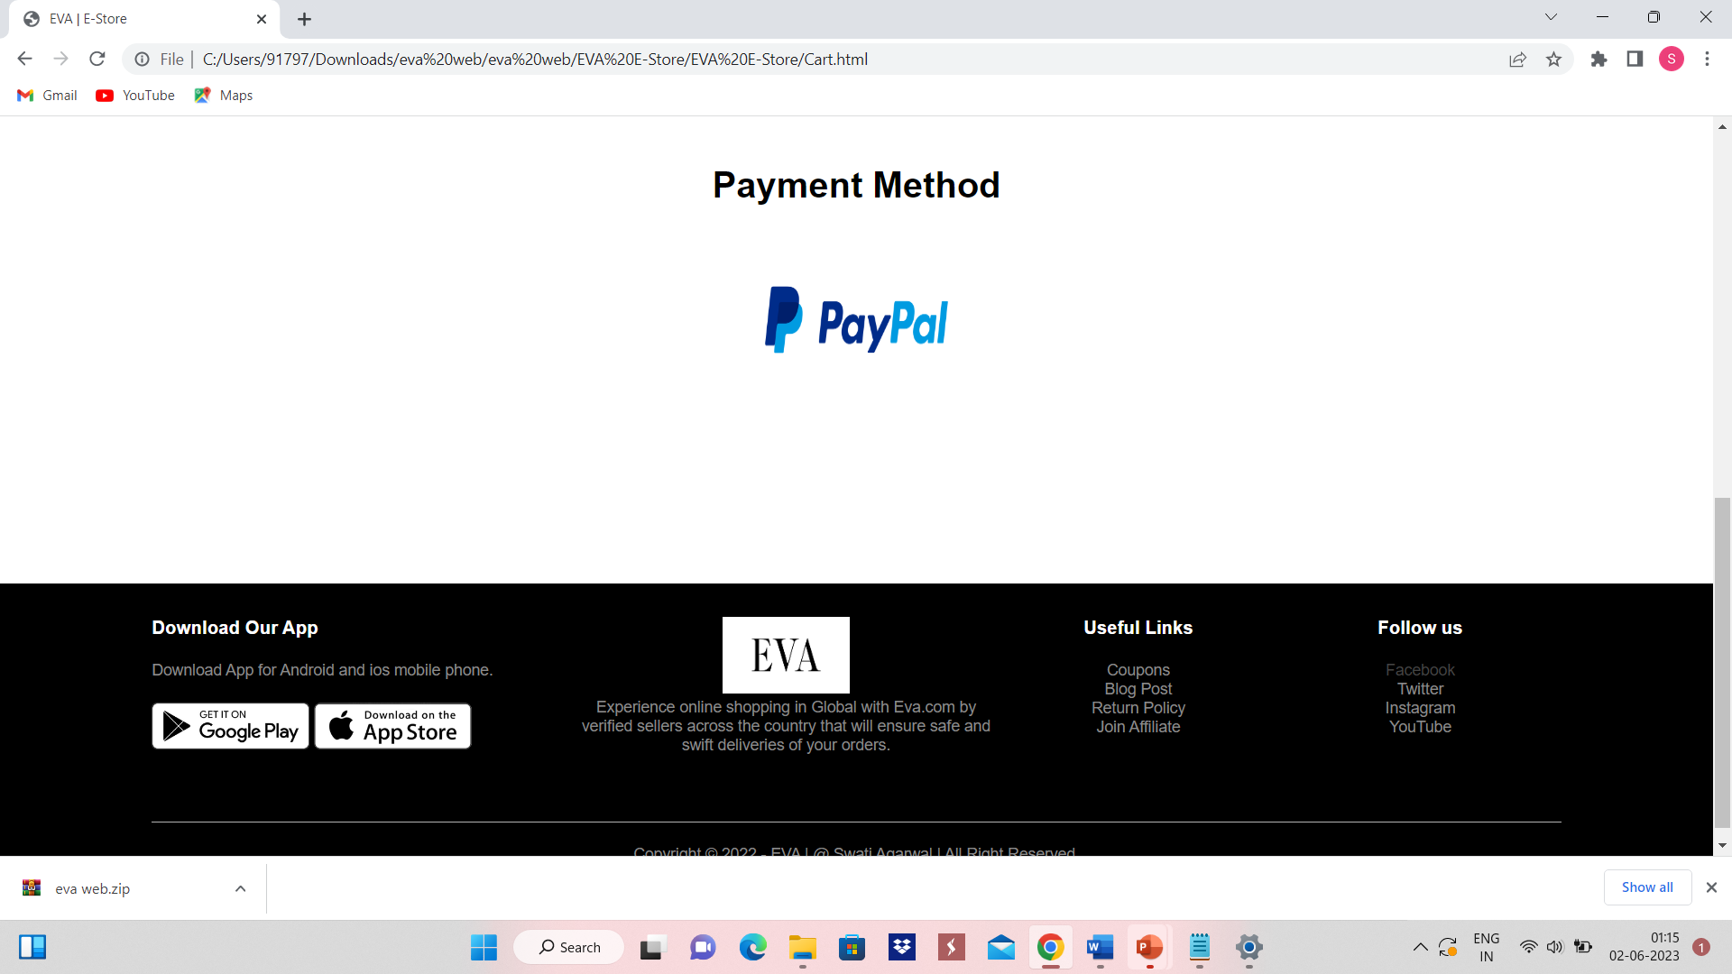
Cart Page

Slide 16

Future Plan
I will include more functionality as per the user requirements.
I will improve my home page, as it is the main thing which attracts all user
Add many new and more products in it to make it more comparetable and user friendly.

Slide 17

Thank you
Swati Agarwal
A217145022006
MCA SEM 2

